Slide 1
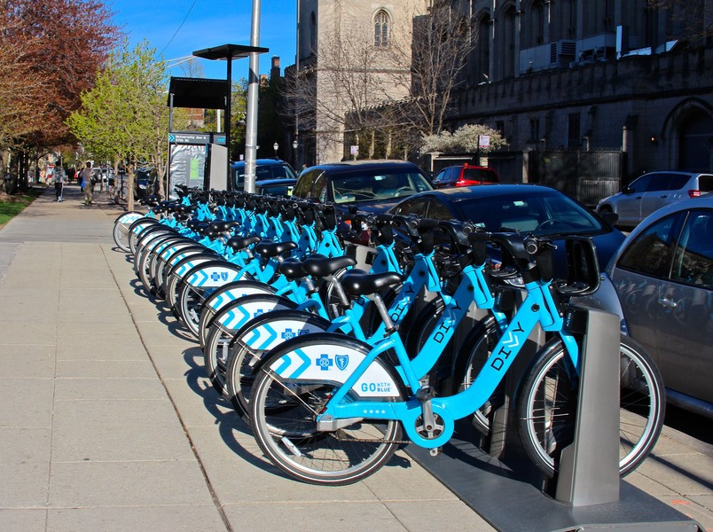

Cyclistic Bike-Share
Unveiling Usage Trends and Conversion Strategies
Yassine El Qaboury
2023-11-24

Slide 2
Content
Introduction
Problem Statement
Data Source
Data Analysis
Data Visualization and Insights
Summary
Recommendations

Slide 3


Introduction
1
2
Cyclistic Overview
Marketing Strategy Evolution
Launched bike-share in 2016 in Chicago
Fleet: 5,824 bikes across 692 stations
Bikes can be unlocked and returned to any station
Initially focused on general awareness
Offered flexible pricing (single-ride, full-day passes, annual memberships)
Found annual members more profitable than casual riders
3
4
Marketing Objective Shift
Conversion Strategy
Moreno aims to convert casual riders into annual members
Leveraging existing awareness of the program
Analyzing trip data to understand customer behaviour
Analyzing historical bike trip data
Identifying differences between casual riders and members
Using digital media to enhance marketing tactics

Slide 4

Problem statement
1
Problem
2
Objectives
Understand usage differences between casual riders and annual members at Cyclistic
Design a strategy to convert casual riders into annual members
Analyze historical bike trip data for insights
Identify reasons why casual riders might opt for a membership
Determine how digital media can enhance marketing tactics
3
Challenges
Recommendations must be data-drive and compelling
Approvals needed from Cyclistic's detail-oriented executive team

Slide 5

Data
1
Data Source
2
Data Selection
Public historical trip data provided by Motivate International Inc.
Available under a specific license.
Organized in CSV files with 13 variables in a long format.
Spans from 2013 to 2023.
Fits the analysis criteria: ROCCC approach - Reliable, Original, Comprehensive, Current, and Cited.
Focused analysis from November 2022 to October 2023.
Chosen for relevance to the current business task.

Slide 6

Analysis
1
2
Ms Excel (power Query Editor)
RStudio
Column Refinement:
Removed unnecessary columns (e.g., latitudes, longitudes).
Feature Generation:
Created 'ride_length' (trip duration) and 'day_of_week' columns.
Data Refinement:
Eliminated rows with negative or zero ride lengths.
Managed duplicates, empty cells, inconsistent formatting, errors, and non-printable characters.
Merged data into one dataset
Conduct Analysis for data cleaning and analysis
Created pivot tables and visualizations

Slide 7
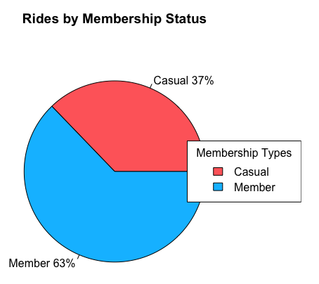
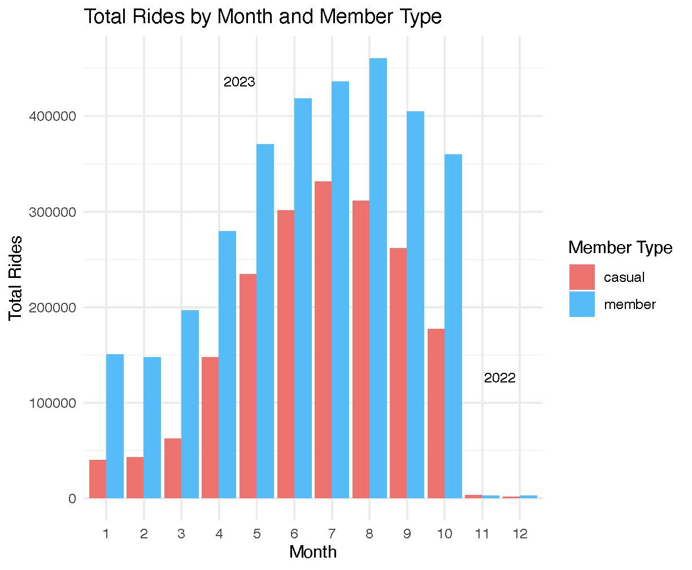
Data Visualization: Part 1
1
2
The membership Status of The Riders
The Number of Rides Among Riders per Months

Slide 8
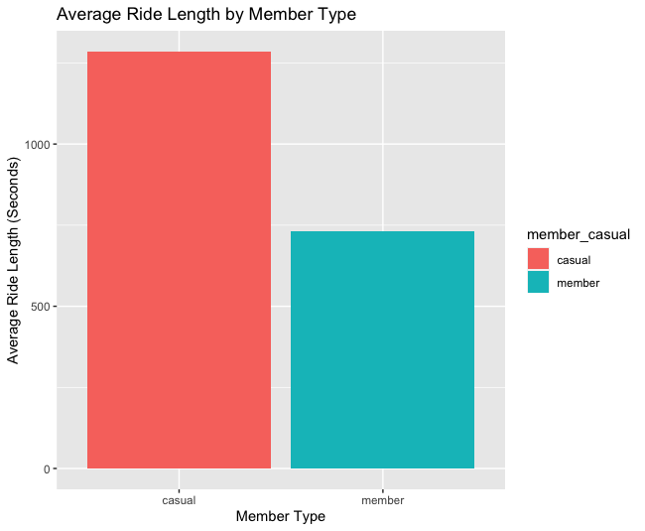
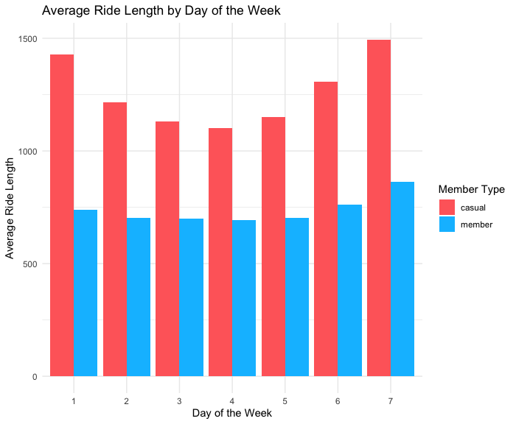
Data Visualization: Part 2
3
4
The Average Ride Length for Users
The Average Ride Length for Users by Day of Week

Slide 9
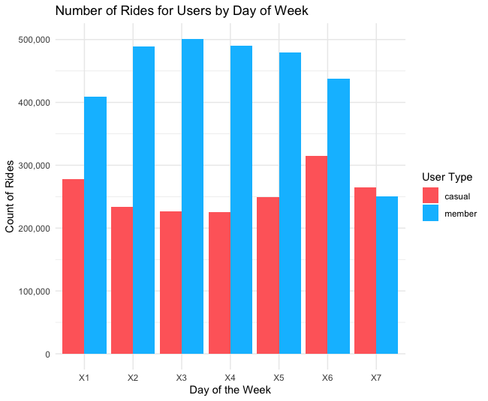
Data Visualization: Part 3
5
The Number of Rides for Users by Day Of Week by adding Count of trip id

Slide 10
Data Visualization Insights:
1
2
3
4
Membership status
Monthly Ride Counts
Average Ride Lengths
Ride Lengths by Day of Week
63% rides from members, 37% from casual riders.
Members use the service more frequently.
Members consistently ride more than casual riders.
Casual rides peak in summer.
Casual riders take longer rides than members.
Casual riders consistently have longer average ride durations across the week.
5
6
Ride Count by Day of Week
Behaviour Patterns
Members use the service significantly more than casual riders across all days, indicating higher frequency.
Members display more consistent and sustained usage, while casual riders show more varied behavior.
Casual riders prefer longer rides, possibly for leisure or occasional transportation.
Member riders show more routine usage, likely for regular commuting or specific purposes.

Slide 11
Recommendations:
1
2
3
4
Targeted Membership Campaigns
Seasonal Promotions
Customized Service Offerings
Enhanced Convenience for Members
Develop targeted campaigns emphasizing the value of annual memberships. Highlight benefits like cost-efficiency and service reliability to encourage casual users to transition.
Leverage seasonal trends by offering tailored promotions during peak months for casual riders. Create incentives or special packages to encourage membership sign-ups during these periods.
Tailor services for varying ride preferences. For casual riders favoring longer rides, introduce extended ride packages or explore additional features for leisurely exploration.
Streamline the member experience with added convenience features like priority access, rewards for frequent usage, or exclusive perks to encourage routine usage.
5
6
7
8
Feedback Mechanisms
Engagement Strategies
Simplified Sign-Up Process
Service Adaptation
Establish feedback loops to understand user needs better. Collect insights from both casual and member riders to continually refine service offerings.
Foster community engagement among members through events, forums, or social platforms, reinforcing the sense of belonging and shared benefits.
Simplify the transition process from casual to member status, ensuring an easy and intuitive sign-up experience to minimize barriers.
Adapt services based on user preferences. Explore adjustments in bike availability, route suggestions, or add-ons to cater to diverse usage patterns.

Slide 12
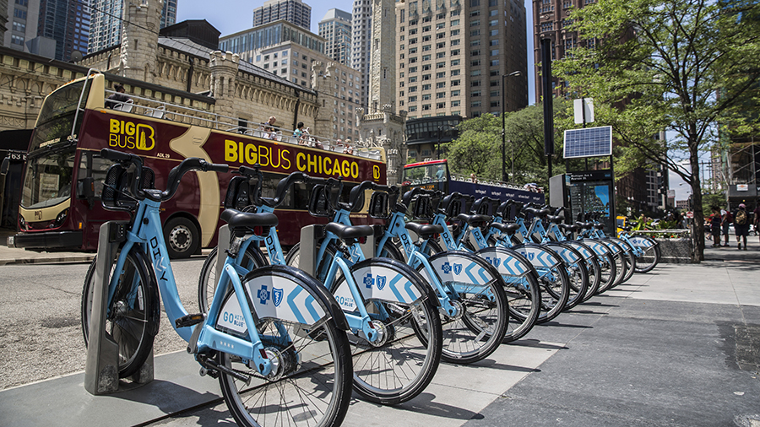
Thank you
Do you have any questions ?
Yassine El Qaboury
2023-11-24

